Slide 1
Advanced mathematics II
Teacher: Xia Liang-Hui
Office Room：#315， Nanhai Building,
Main Campus
Email: xlhui2004@163.com
Answer questions Group: QQ group 766347973

Slide 2


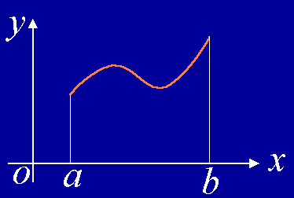

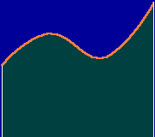

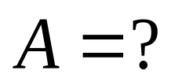

5.4 Definite integrals
The area of rectangle
The area of trapezoid
1. The area of curved sided trapezoid
The region is enclosed by the curve
the x axis, and two lines
, find the area A .

Slide 3
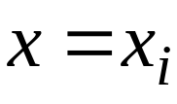
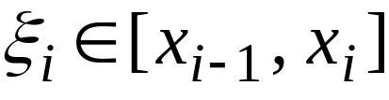
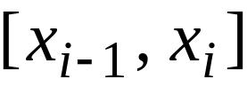

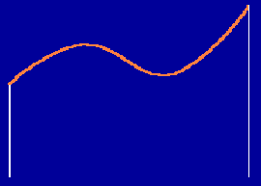
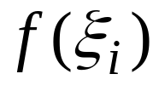






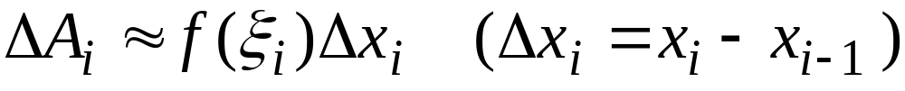

Procedure of finding area:
Step 1:
Insert n –1 points on the intervals [a, b]
Draw lines
, then dived the region into n small regions;
Step 2.
For the i –th small region, select
then make a rectangle with
as its base ,
as its height,
Approximate the i –th small region
by this rectangule,
therefore,

Slide 4
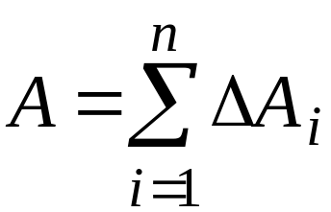
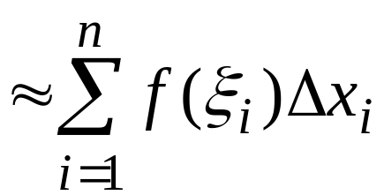

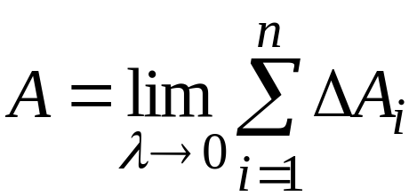
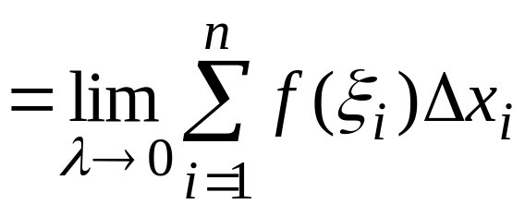
3) Approximated sum
4) Taking limits.
Let
then the area is

Slide 5




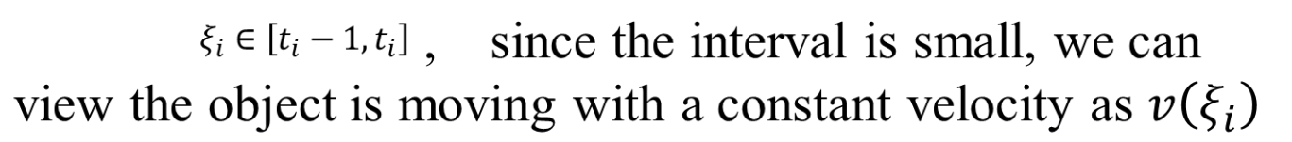
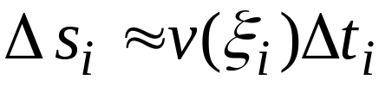

2. The distance of a linearly moving object with non-constant velocity
The object is moving along a line,
the velocity is
and
find the covered distance s.
Procedure of finding distance:
1)
Divide the interval [T1,T2] into n subintervals
the distance covered on each time interval is represented by
2) Choose

Slide 6



3) Therefore, the total covered distance
4) Taking limit:
Two questions in common:
Solved by the same procedure
Taking the limit of a sum of products

Slide 7
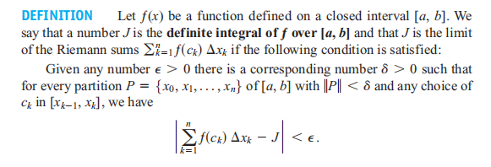
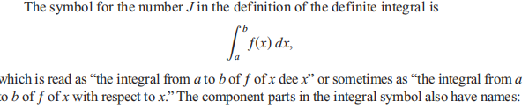
Definition:

Slide 8
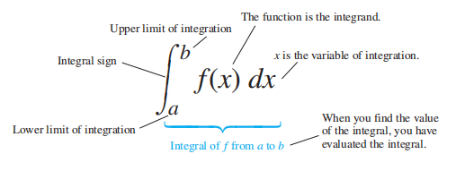

Slide 9
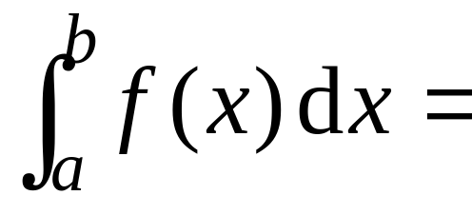
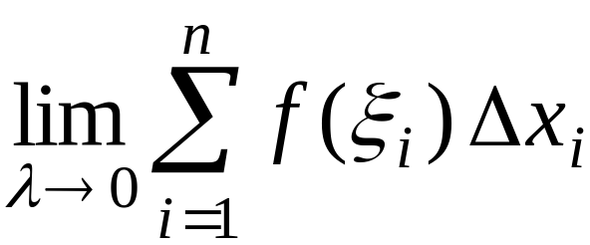
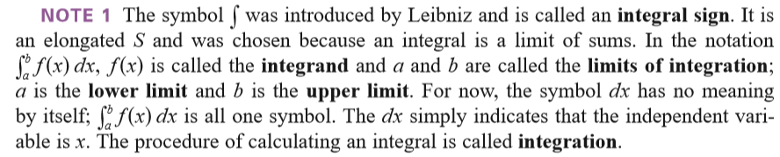
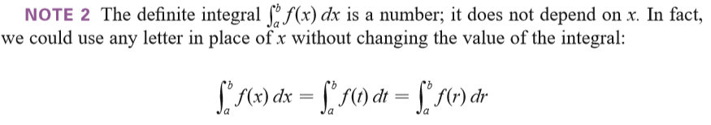

Slide 10

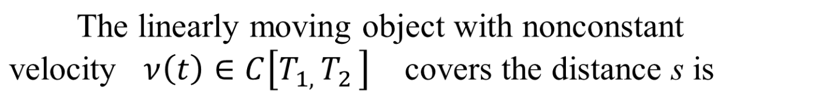
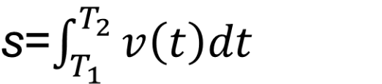
By the definition, the area of curved sided trapezoid

Slide 11

The conditions of integrability:

Slide 12
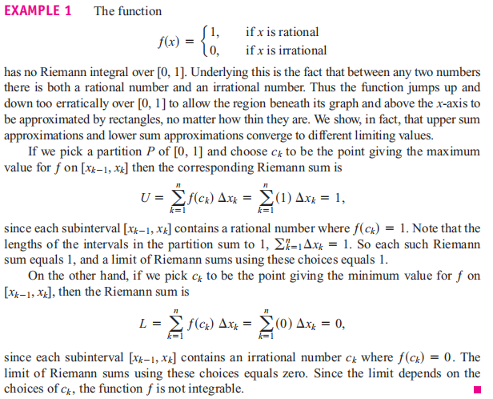
One example, the function is not integrable

Slide 13
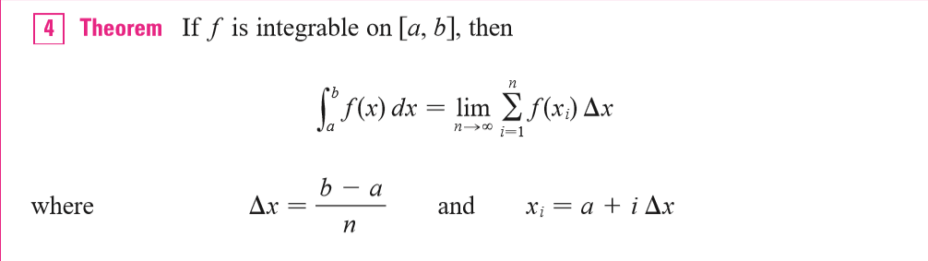

Slide 14




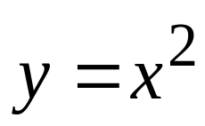








Example 1. Using the definition to calculate
Solution:
Dividing [0,1] into n equal subintervals, the partion points are
Taking
then

Slide 15
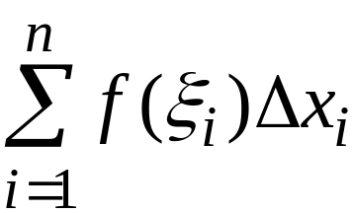
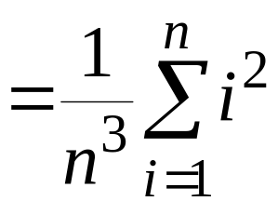
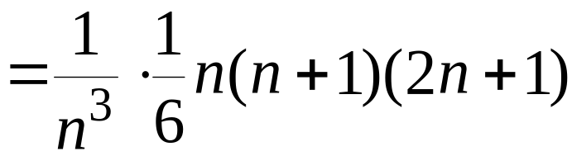
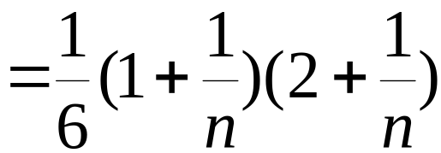
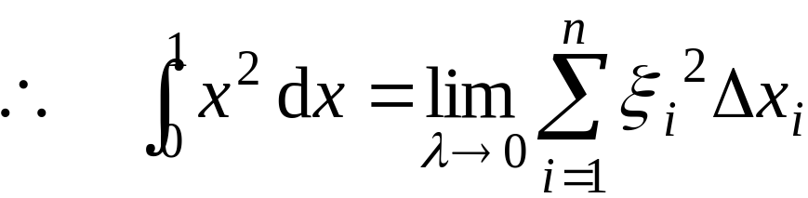

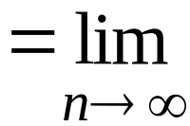
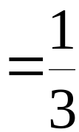

Slide 16
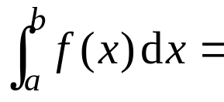
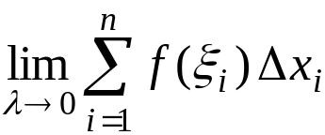
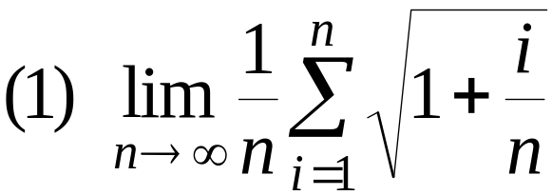
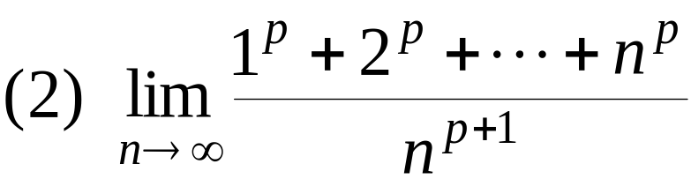
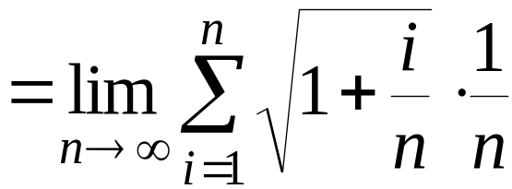
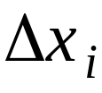

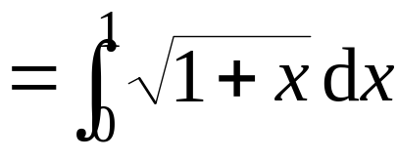



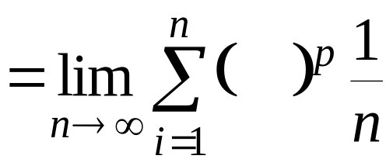

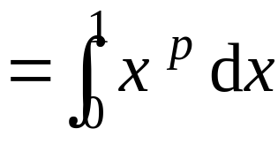
Example 2. Using definite integrals to represent the following limits
Solution:

Slide 17

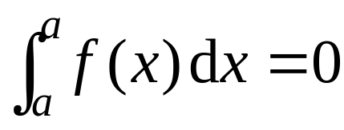
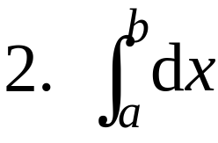


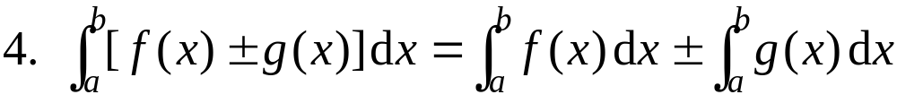
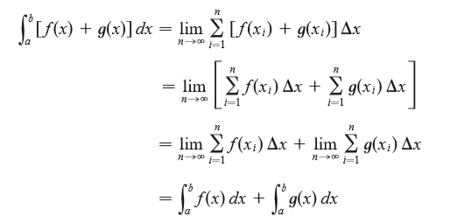
Properties of the Definite Integral
( k is a constant)
Proof:

Slide 18

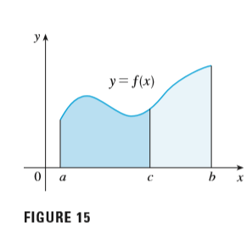

Slide 19

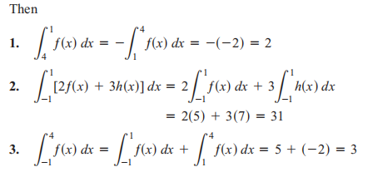

Slide 20
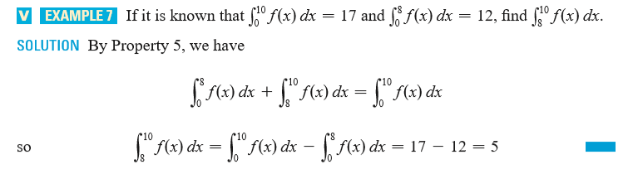

Slide 21


Slide 22


Slide 23








Corollary:
Proof:
then

Slide 24



Slide 25





9. Mean value theorem of integral
If
then there exists at least a
such that
Proof: Suppose the absolute minimum and maximum of
f (x) on [a, b] are m, M, then by property 8,
By the intermediate value theorem of a continuous function on a closed interval, there exists at least a
such that
which is equivalent to the final result.

Slide 26


Average Value of a Continuous Function

Slide 27


Slide 28















Exercise:
1. Using definite integrals to represent the following limit :
Solution:
or

